Slide 1


Mall Dataset
Ryan Meston Bellevue University

Slide 2
Abstract & Project Questions
The questions I am going to ask are:
Which customers are low, medium, and high value customers?
Which gender and age group are more willing to spend money?
Does income determine how much one will spend?
What groups are the best target audience for ads and coupons?

Slide 3
Introduction & Background
Dataset Columns
CustomerID – customer identification number
Genre – gender of customer.
Age – age of customer.
Annual Income (k$) – annual income of customer.
Spending Score (1-100) – spending score, how much the customer is willing to spend.

Slide 4
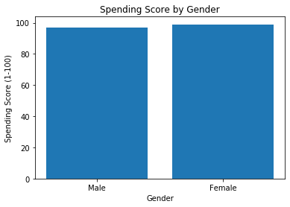
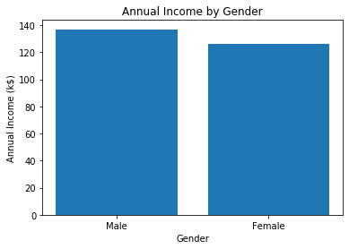
Methodology

Slide 5
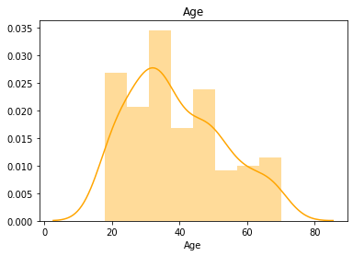
Age Distribution
count 200.000000
mean 38.850000
std 13.969007
min 18.000000
25% 28.750000
50% 36.000000
75% 49.000000
max 70.000000

Slide 6
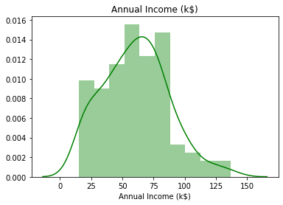
Annual Income Distribution
count 200.000000
mean 60.560000
std 26.264721
min 15.000000
25% 41.500000
50% 61.500000
75% 78.000000
max 137.000000

Slide 7
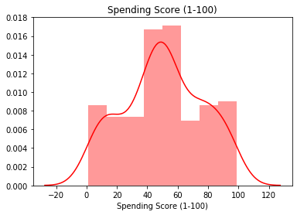
Spending Score Distribution
count 200.000000
mean 50.200000
std 25.823522
min 1.000000
25% 34.750000
50% 50.000000
75% 73.000000
max 99.000000

Slide 8
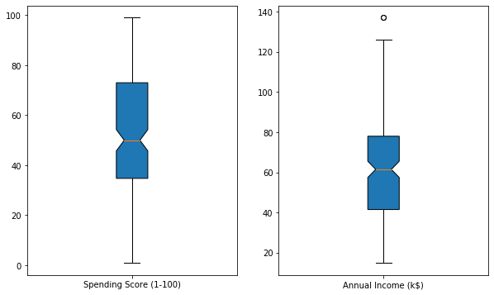
Spending Score Compared to Annual Income

Slide 9
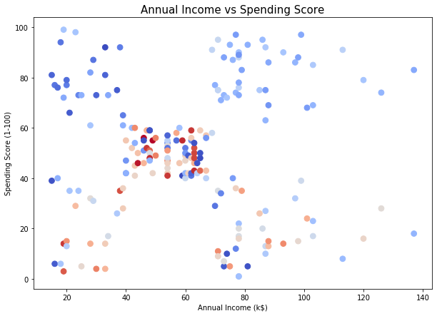
Annual Income vs Spending Score by Age

Slide 10
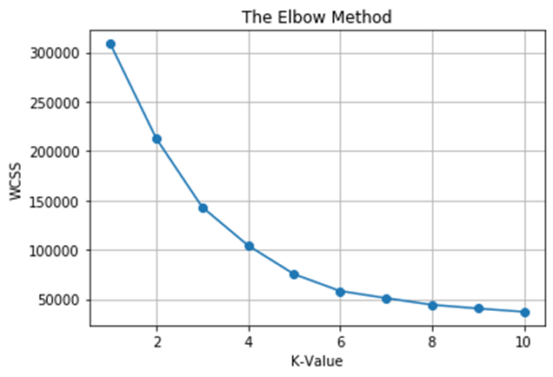
Results

Slide 11
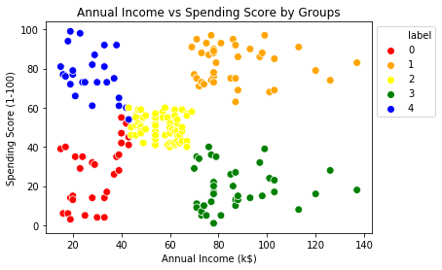
Results Continued

Slide 12
Project Question Results
Which customers are low, medium, and high value customers?
Red Group – lowest annual income and spending score.
Green Group – above average annual income with a low spending score.
Yellow Group – average annual income and average spending score.
Blue Group – low annual income and high spending score.
This group loves to spend money, but how much do they have to spend?
Orange Group – high annual income and high spending score.
I would target the orange clients with marketing ads to increase consumer spending at stores.
Which gender and age group are more willing to spend money?
Females spend slightly more than males do in this dataset.
19–40-year-olds are the most willing to spend money.
Does income determine how much one will spend?
With this dataset I do not believe income relates to how much someone will spend. There are different groups that have a high annual income and have a low spending score. There are also groups with low annual income and very high spending scores.
What groups are the best target audience for ads and coupons?
The Orange Group is the best group in this scenario to target for ads and other marketing techniques. This group has the highest annual income and the highest sending score.

Slide 13
References
Thakur, Shivashish. 2020. KDnuggets.com. 21 Machine Learning Projects – Datasets Included. https://www.kdnuggets.com/2020/03/20-machine-learning-datasets-project-ideas.html
Kaggle.com. Mall Customer Data CSV File. https://www.kaggle.com/shwetabh123/mall-customers
Khalid, Irfan Alghani. June 1, 2020. Customer Segmentation in Python. https://towardsdatascience.com/customer-segmentation-in-python-9c15acf6f945
Adithyan, Nikhil. November 20, 2020. Customer Segmentation with K-Means Python https://medium.com/codex/customer-segmentation-with-k-means-in-python-18336fb915be
Scikit-learn. Package Information for Clustering and K-Means. https://scikit-learn.org/stable/modules/generated/sklearn.cluster.KMeans.html
Analytica Vidhya. April 26, 2021. K-Means Clustering Simplified in Python. https://www.analyticsvidhya.com/blog/2021/04/k-means-clustering-simplified-in-python/
Analytica Vidhya. January 28,2021. Profiling Market Segments Using K-Means Clustering. https://www.analyticsvidhya.com/blog/2021/01/profiling-market-segments-using-k-means-clustering/
Karaman, Baris. May 4, 2019. Customer Segmentation. https://towardsdatascience.com/data-driven-growth-with-python-part-2-customer-segmentation-5c019d150444
Nemke, Mike. June 5, 2021. Customer Segmentation: A Technical Guide with Python Examples. https://www.mktr.ai/applications-and-methods-in-data-science-customer-segmentation/
Sagar, Abhinav. 2019. KDnuggets.com. Customer Segmentation Using K-Means Clustering. https://www.kdnuggets.com/2019/11/customer-segmentation-using-k-means-clustering.html

Slide 14
10 Questions
What age group/age range makes the most money?
What age group/age range spends the most money?
What age group/age range makes the least money?
What age group/age range spends the least money?
After we determine clustering, how can we identify customers to market towards?
What causes groups with lower incomes to have a higher spending score?
What cause groups with higher incomes to have a lower spending score?
What types of items our customers spending their money on?
Do customers spend more on needs or wants?
How can you predict spending score of a customer?

